Slide 1






Untangling Header Bidding Lore
Some myths, some truths, and some hope
Waqar Aqeel, Debopam Bhattacherjee, Balakrishnan Chandrasekaran, Philip Brighten Godfrey, Gregory Laughlin, Bruce M. Maggs, and Ankit Singla
Notes:
I’m Waqar
Thank you
PAM2020
Co-authors
This work part of larger cspeed group. Universities
Why important
Let’s understand the actors and how it works
Simplified view

Slide 2






How (traditional) Real-Time Bidding Works
Publisher Web Server
4. Ad Slots
5. Bid requests
8. Bids
7. Bid responses
Ad Exchange 1
10. Bid requests
11. Bid responses
1. Web request
2. Web response
Ad Exchange 2
Advertiser(s)
6. User Data
3. Ads Request
9. Ad Slots
Browser
11. Final ads
10. Bids
Ad Server
Data Broker(s)
Notes:
Explain timeout
And auction duration

Slide 3
How Header Bidding Works
Publisher Web Server
1. Webpage request
2. <javascript>
Ad Server
3. Ad Slots
8. Highest bids
Browser
7. Bids
9. Final ads
4. Bid requests
5. User Data
6. Bid responses
Ad Exchange 2
Ad Exchange 1
Advertiser(s)
Data Broker(s)
Notes:
Explain timeout
And auction duration
Show javasceript in flight
Sho multiple excahnges

Slide 4
Header Bidding Background
Started in 2013 to take wrestle control back from big players (Google)
Waterfall model used to favor particular exchanges
Parallel process guarantees fairness for all
May increase revenue because more buyers can bid
80.2% adoption among top 1K publishers
Online advertising is a $300 billion industry
Latency-critical process
Notes:
Break into two slides
Google controls which exchanges explain point 1
Slide 2
Put a quote from previous work
Why there is latency and not fundamental

Slide 5
Previous work
Only one measurement study on header bidding:
Scraping instead of real user data
Single vantage point
Unrealistic bids
Less focus on latency
“Non-Viable Performance Overheads”
Using real data and a deeper dive into latency, we show that latency overheads are not fundamental

Slide 6
What was measured? How?
Browser extension¹ for Firefox and Chrome measures:
Prebid.js library logs for ad slots, exchanges and bids
PerformanceTiming API for timing breakdown of bid requests and responses
WebExtensions API for IP addresses of ad exchanges
Domain name of page visited
Users’ city-level location
Privacy of users considered – IRB review
Attribute | Value
Users | ≈ 400
Duration | 8 months
Cities | 356
Countries | 51
Websites | 5,362
Ad exchanges | 255
Page visits | 103,821
Auctions | 393,400
Bids | 462,075
1. Extension source code and dataset available: https://myadprice.github.io
Notes:
Source code and dataset available
Cannot differentiate one user’s visit from others’
No unique ID
Half from US. Rest mostly from Europe. India, Canada, Turkey among notable others

Slide 7
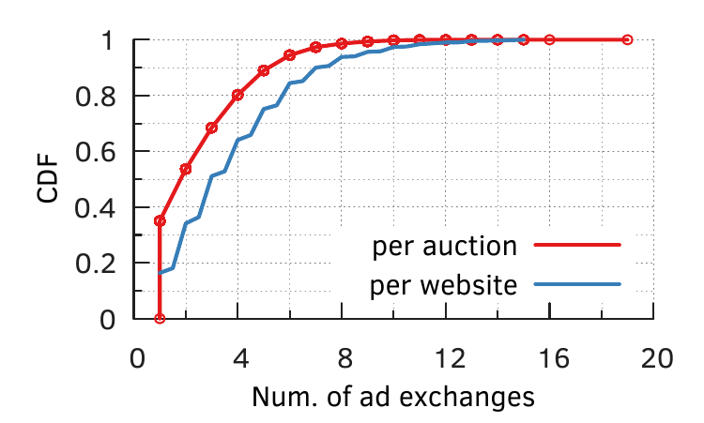
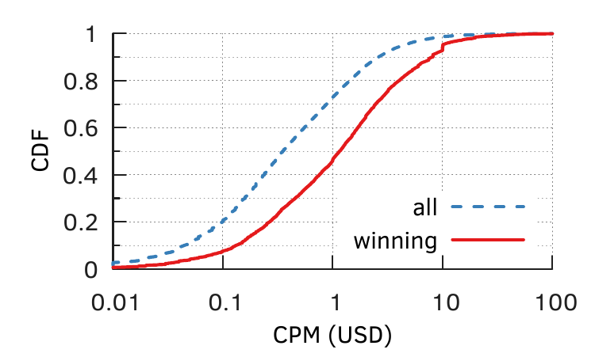
The Revenue-Latency Tradeoff
Does it make sense to contact as many exchanges as possible?
Publishers are conservative: ~60% contact at most 4 exchanges
All bids are not the same
Median winning CPM is $1.15, while median non-winning is $0.35
Notes:
We saw 255 ad exchanges
Perhaps all bids are roughly the same
So it doesn’t matter much if you contact more exchanges

Slide 8
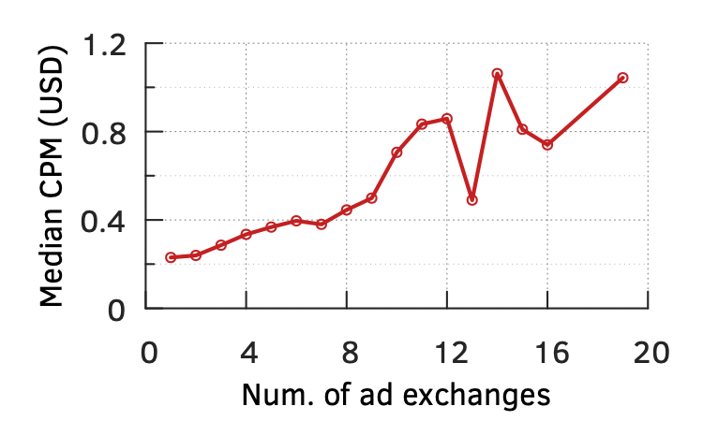
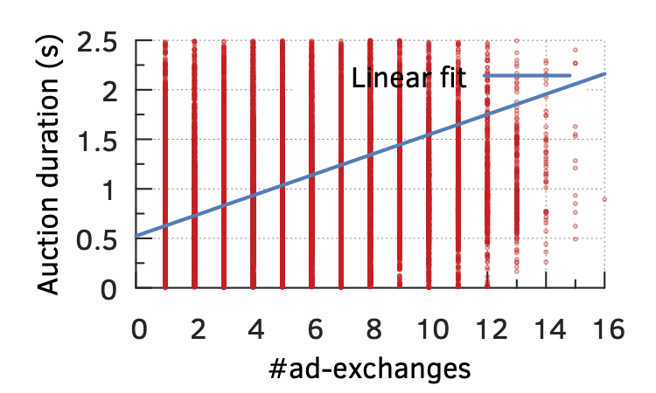
The Revenue-Latency Tradeoff
Contacting more exchanges increases CPM for an ad slot
Going from 1 to 8 exchanges doubles median CPM
But also increases auction duration
Delay in showing ads = bad user experience, perhaps lower click rate
Notes:
About 90% data in 8 exchange range
It’s a very rough correlation, but there does seem to be one
Delay is known to cause drop in ecommerce
Search click through is also reduced if delayed

Slide 9
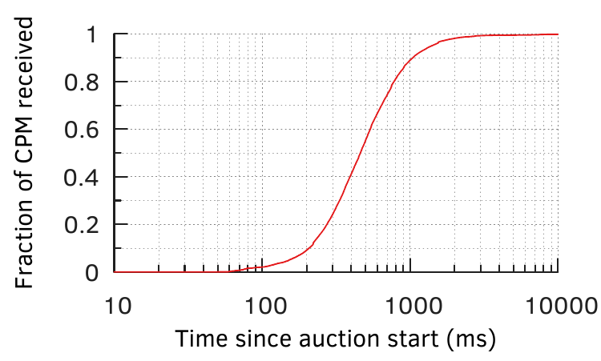
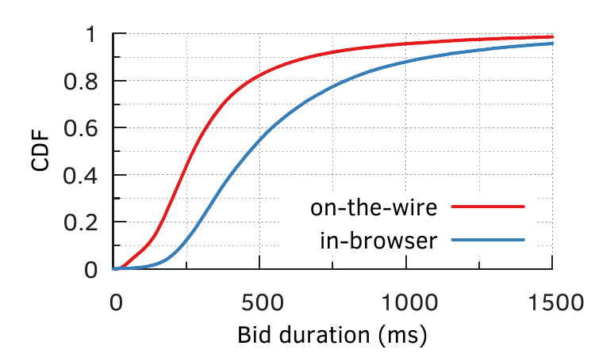
Latency Breakdown
Time wasted on waiting for bids that will probably not alter the auction result
Prioritizing other content, inefficient JavaScript implementations, even synchronous.
Contributes 174ms in the median
Notes:
We saw that 90% bids and CPM arrive within 1 second, yet publishers set timeouts of 3 seconds.
Publishers could shorten the timeouts
Bid requests are supposed to be asynchronous. Some implementations are buggy and synchronous
Waste everybody’s time

Slide 10
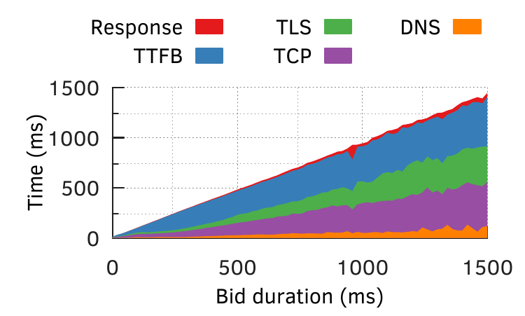
Latency Breakdown
60% requests made on pre-existing, persistent connections
median duration is 230 ms
Time To First Byte (TTFB) dominates
For the 40% non-persistent
median duration is 352 ms
TCP and TLS handshakes are 38% in the mean
Lack of support for low-RTT protocols. TLS 1.3 (11.4%), QUIC (6.6%), TCP Fast Open (76% but tricky)
Notes:
Explain what TTFB is: one RTT + server processing
Explain what other graph labels are
38% in the mean. Because most auctions are below 400 mark where TTFB dominates
TLS 1.3 is one RTT less than 1.2.
TCP Fast Open. Explain disabling by Linux, Mac and Windows clients

Slide 11
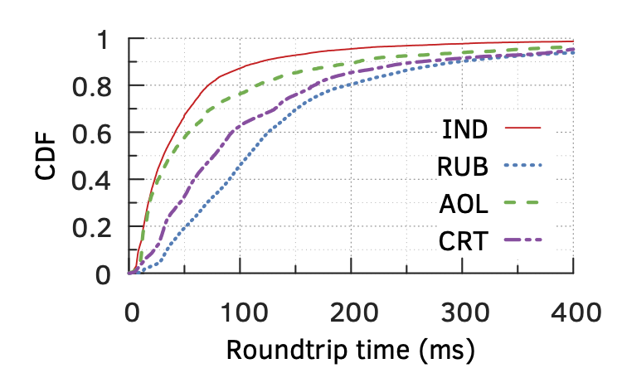
Exchange Infrastructure
Distributed deployments:
Index Exchange (IND): 88
Rubicon (RUB): 20
(AOL): 20
Criteo (CRT): 20
Sometimes bad routing by ad exchanges
Large RTTs
Large variation in RTTs for users in the same city against one exchange
Notes:
So distances are higher
May be anycast. We can’t be sure that it’s not. But RTTs suggest that it’s not anycast
Change graphs into roundtrips

Slide 12
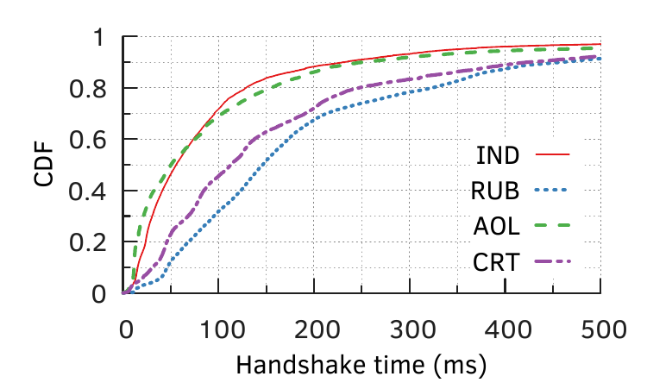
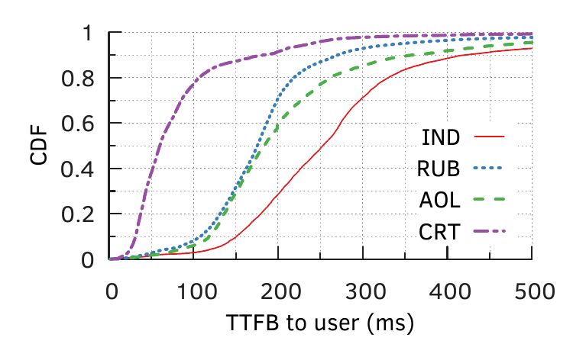
Exchange Infrastructure
CRT, AOL gain in handshake time by supporting TLS 1.3
TTFB dominates for most auctions
CRT has huge advantage
IND suffers
Unknown reasons, no visibility
Notes:
IND and RUB don’t support TLS 1.3 and lose
TTFB contains within it the exchange-side auctions
TTFB is one RTT plus server processing
It seems that Criteo does not spend any network time on getting bids

Slide 13
Conclusions
The revenue-latency tradeoff is valid
Inefficiencies at the implementation and infrastructure levels
Exchange-side auctions can be optimized
Low RTT protocols and enhancements should be adopted
Header bidding latency is not a fundamental problem
Published at the Passive and Active Measurements Conference 2020
Won Best Dataset Award
Notes:
Previous work did not do real user measurements
Latency from one vantage point
No real revenue data
No breakdown of latency
Optimize auctions like Criteo does
Block tracking, allow ads
Send targeting selected info from browser
These ideas have appeared before but there is someone at the center. Like Brave.

Slide 14
Future Work
Increase measurement coverage
From ad exchange perspective
Revenue comparison with traditional real-time bidding
Privacy-preserving advertising
Browser is in control
Store targeting information locally, send with ad requests
Like Privad, Brave Ads

Slide 15
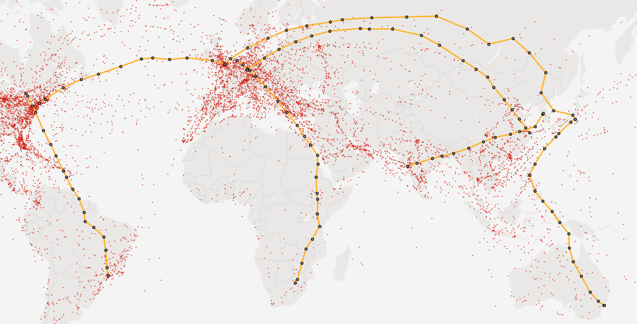
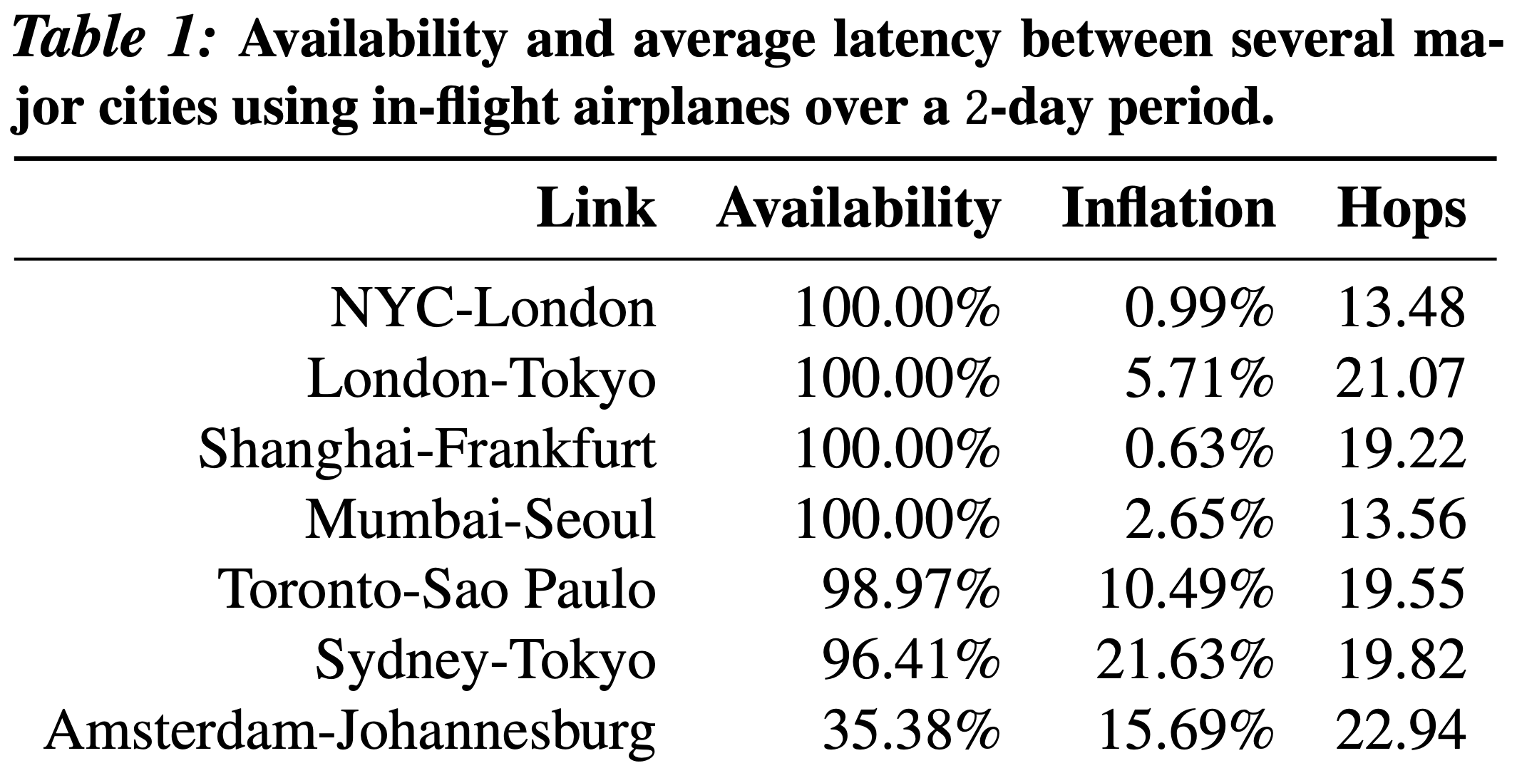
Other Projects
Gearing up for the 21st Century Space Race [HotNets 2018]
Low-orbit satellites for global Internet
Airplanes for major population centers

Slide 16
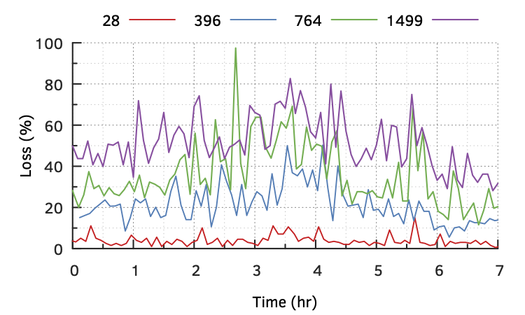
Other Projects
cISP: A Speed-of-Light Internet Service Provider
Design proposal for microwave backbone over mainland US and continental Europe
Weekly tests on a microwave path between NY and Chicago
High losses due to weather

Slide 17
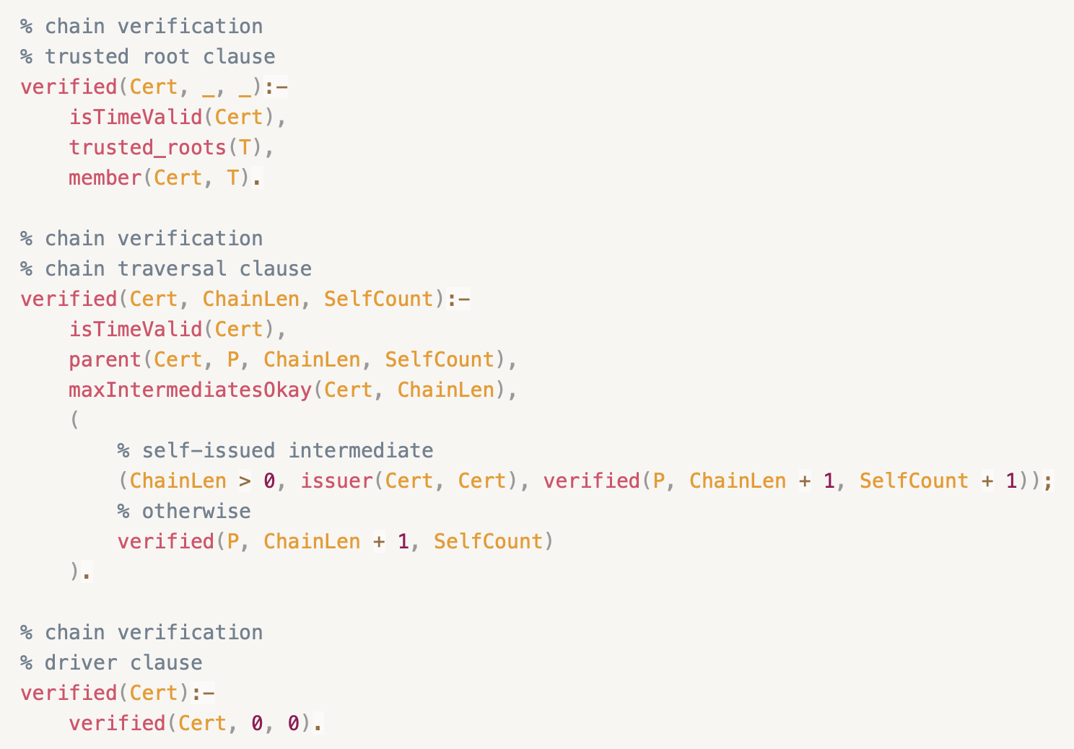
Other Projects
Assertion Containing Certificates
Certification verification logic in the certificate itself
Evolvable TLS PKI
Translated a TLS library (mBedTLS) from C to embeddable Prolog

Slide 18
Thank you! Questions?

